Slide 1
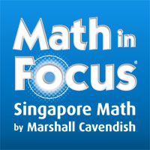
Math in Focus
Rivendell School Town Meeting
October 19, 2017

Slide 2
Implementation Process and Timeline
Grades 5-6 Implemented Math In Focus during the 2016-2017 school year
Teachers participated in professional development during the summer of 2017
Implementation began in September for grades K-4

Slide 3
Math in Focus Framework
Notes:
Based on 5 principles – key components, as you would expect are skills, concepts, and processes. However these are incomplete without an intentional focus on attitude and metacognition

Slide 4
Key Features of Math in Focus
A focused and coherent syllabus
A visual and balanced approach
An emphasis on problem solving using model-drawing
A focus on number and operations
A recognition of the importance of attitudes and metacognition
Notes:
Based on this framework, Math in Focus has 5 key features upon which I will elaborate

Slide 5
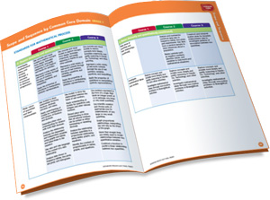
A Focused and Coherent Syllabus
Math in Focus introduces fewer topics in each grade, but teaches them to greater depth. Topics are taught to mastery, so they build from year to year across grade levels without repetition.
The concepts and skills are intentional, designed to prepare students for success in more advanced mathematics.
Concepts are covered thoroughly when introduced and each grade builds on the previous grade.
Notes:
Compared with Everyday Math, you may have noticed less spiraling and an intentional effort to teach to mastery.

Slide 6
A Visual & Balanced Approach
Concrete
Pictorial
Abstract
Notes:
The concrete – pictorial – abstract progression is an integral part of Math in Focus. You might notice and even worry that your first grader spends an awful long time talking about numbers. This is intentional and is designed to help the students develop a strong understanding about their math work.

Slide 7
Concrete – Pictorial - Abstract

Slide 8
An emphasis on problem solving using model-drawing (Bar Modeling)
Math in Focus utilizes model-drawing strategies that help students solve both routine and non-routine problems.
Model drawing is a systematic method of representing word problems and number relationships that is explicitly taught beginning in second grade and extending all the way to algebra.

Slide 9
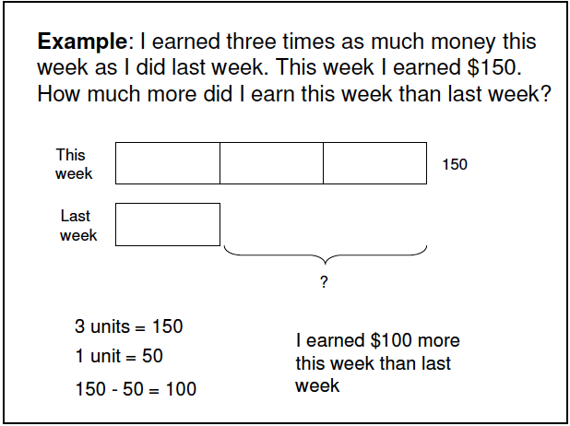
Bar Modeling

Slide 10
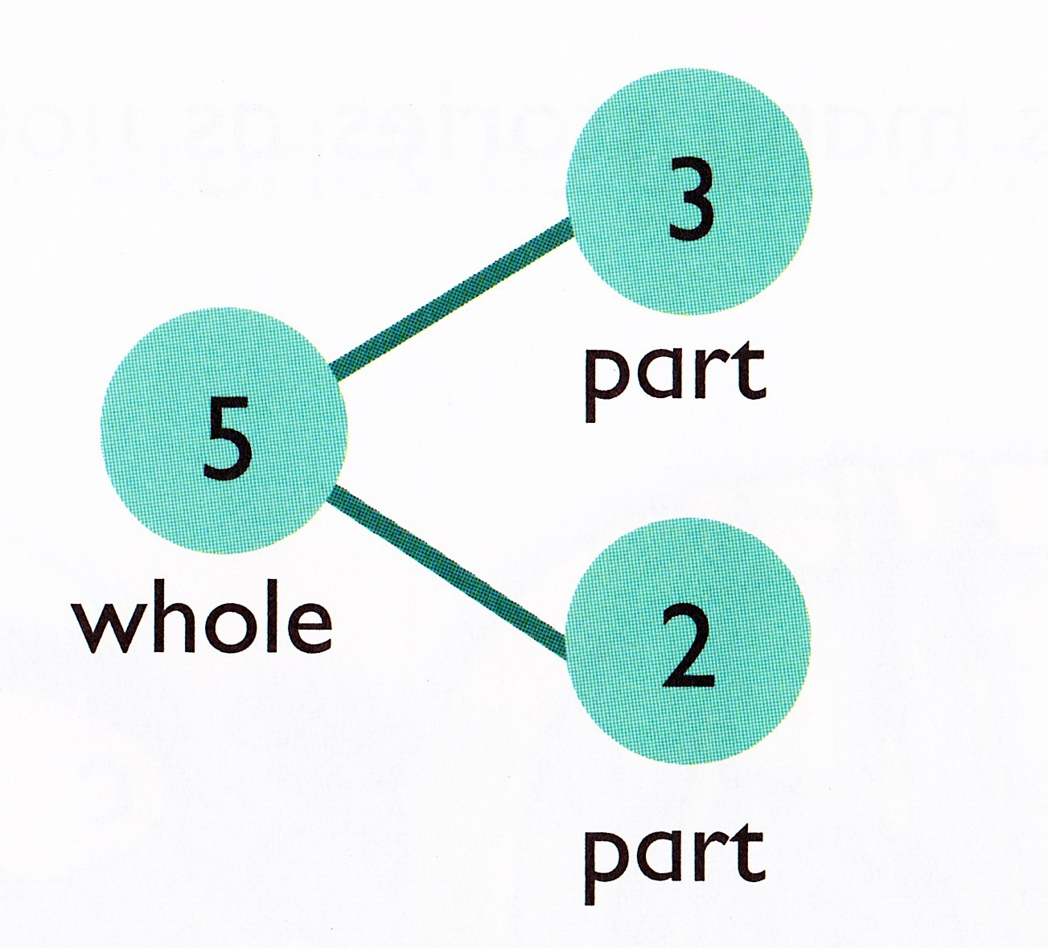
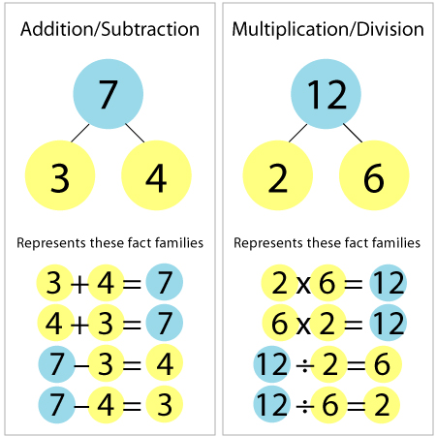
A Focus on Numbers & Operations
Math in Focus is sequenced in a way that ensures students develop and maintain strong number sense. Students spend the majority of the first half of the year studying numbers. This provides the foundation necessary to move on to more complex and abstract thinking.
Notes:
Number sense or numeracy is another key feature of Math in Focus. This curriculum is designed to help children learn to think mathematically with automaticity.

Slide 11
A recognition of the importance of attitudes and metacognition
Math in Focus emphasizes the importance of attitude and the ability to self-monitor while problem solving to achieve success in math.
Math in Focus provides students with the tools they need to break down complex concepts and problems, which in turn develops positive attitudes. Students are taught to appreciate the power of math, persevere and stay positive.
We don’t want to give students permission to denounce math ability early on. People don’t hesitate to say, “I was never good at math either so don’t worry about it.” Rarely do we hear people saying that it is no big deal to be illiterate.

Slide 12
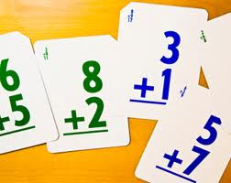
Fact Fluency
“Perhaps students forget their facts because
they learned them by remembering.”
~Yeap Ban Har
Memorization of facts must be coupled
with deep conceptual understanding and a strong
sense of numbers. Memorization alone will not serve our students well.
The expectation in Math in Focus is that students will develop fact fluency with basic facts, but they must first learn the math, understand the relationships between facts and have strategies to calculate a new fact based on a known one. Students learn to verbalize their thinking and become confident in their strategies.

Slide 13
How can I help my child?
Encourage your child to think mathematically and to maintain a positive attitude about math.
Remind them to think about what they are doing not just rely on a procedure or algorithm.
When he is stuck, recommend drawing a model or diagram to represent the problem.
Encourage critical thinking.
Look in the text book or at the online chapter by chapter videos to understand the topics being taught.
Suggest he meet with his teacher to get help.

Slide 14
Resources
http://www.hmhco.com/shop/education-curriculum/math/math-in-focus-singapore-math
http://www.hmhco.com/~/media/sites/home/education/global/pdf/white-papers/mathematics/elementary/math-in-focus/MIF_Model_Drawing_LR.pdf
https://www.youtube.com/watch?v=yp-RmP3ZpcM
https://www.youtube.com/watch?v=yD7ld3hxbYI

Slide 15
Resources Con’t (Chapter Videos)
Kindergarten
First Grade
Second Grade
Third Grade
Fourth Grade
Fifth Grade
Sixth Grade

